Slide 1
Create this web application on Angularjs/Angular.
Use local storage for storing data.
Use Services to Get data from local storage to controller/Component

Slide 2





Opens a popup Go to slide 3 for reference
Edit / Delete option
Delete will delete the task
Edit will open a popup similar to ‘add new task’ popup where user can change the task
Daily Task Manager
ADD New Task
Score=No. of Completed tasks/Total Tasks
If score<33 red color
If score>33 and <66 amber
If score>66 green
Use ngClass here
25%
Pending
In process
Completed
Call Dad
Go Shopping
Homework
Clean Room
Priority Arrow
Up for High
Down for low
Dash for normal
Tasks should be arranged according to Date Time in Descending order
These tasks can be moved only by dragging them to the different sections. This means that the task will have to go to each section one by one.

Slide 3
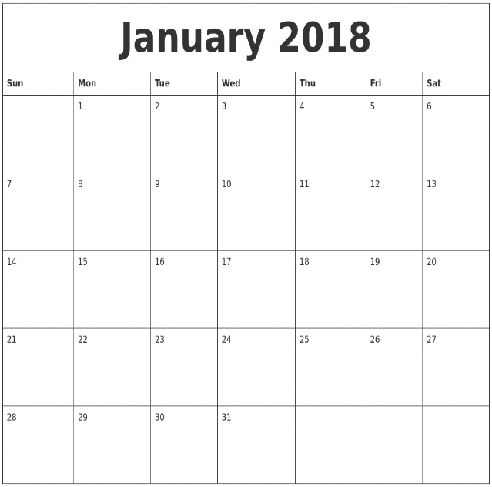
Daily Task Manager
ADD New Task
Date Time Picker – This is for giving the deadline to complete the task
Priority Options :
High
Normal
Low
Pending
In process
Completed
ADD/EDIT Task
Task Title…
Call Dad
Go Shopping
Homework
Clean Room
Description…
--Select Priority--
Description…
Save
Cancel

